Slide 1
Market Mix Modelling
Estimate the effectiveness of investment in media

Slide 2

Notes:
www.thecoregroup.cz

Slide 3
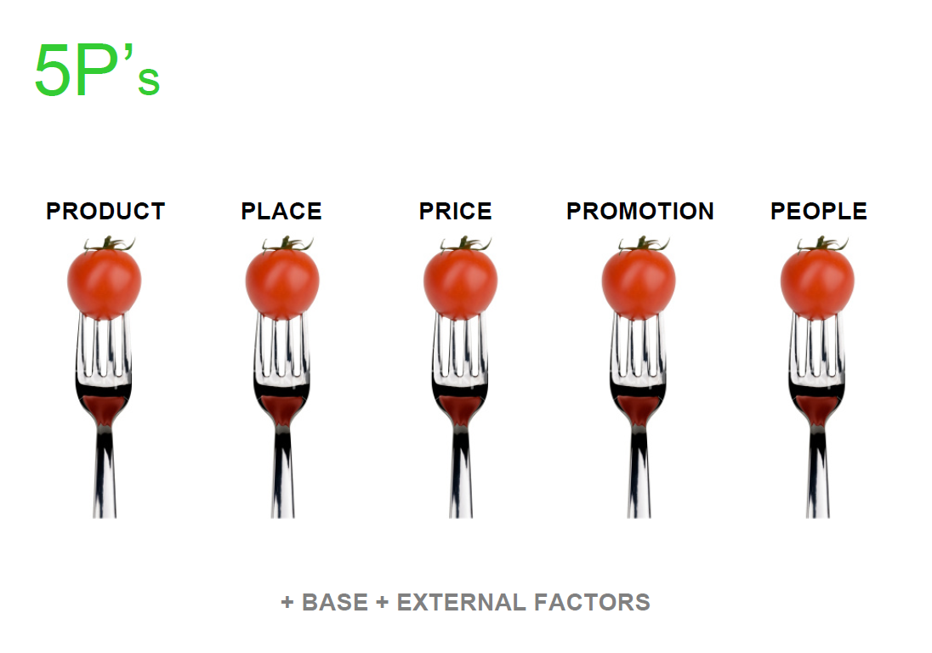
Notes:
www.thecoregroup.cz

Slide 4
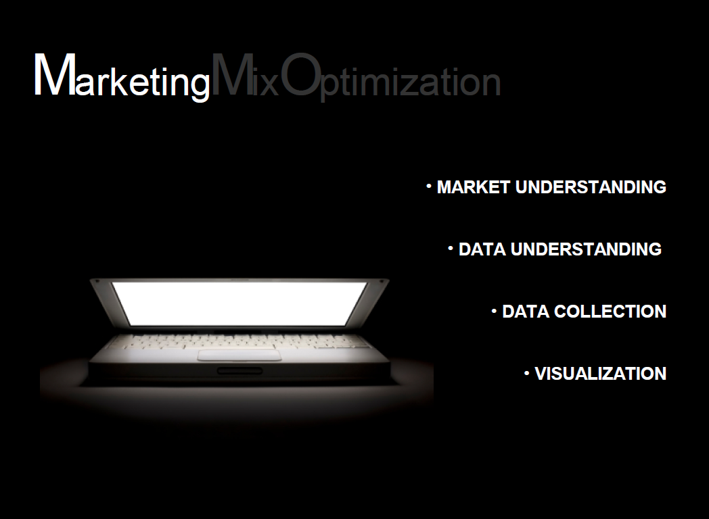
Notes:
www.thecoregroup.cz

Slide 5
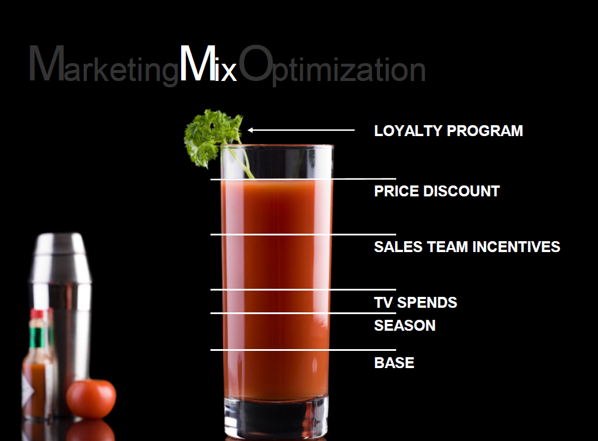
Notes:
www.thecoregroup.cz

Slide 6
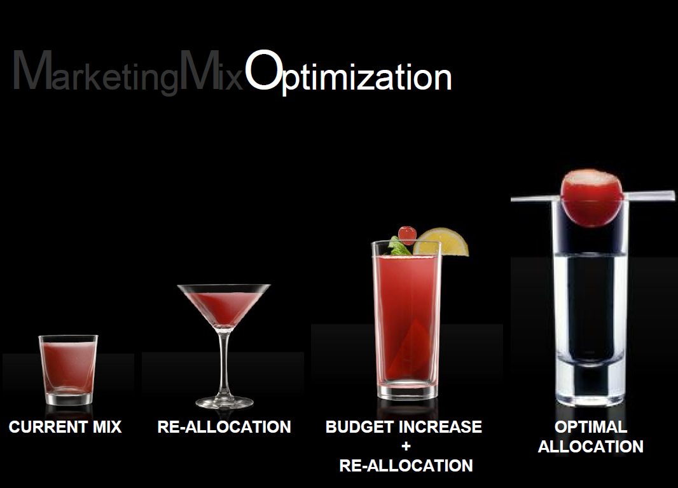
Notes:
www.thecoregroup.cz

Slide 7
Agenda
Business application of Marketing Mix modelling
A case study
Strengths and weaknesses
Brief introduction to more advanced approaches: pooled regressions and structural equations

Slide 8


Making BP’s media dollars work harder
“Mindshare helped BP to make the most of their media investments across the many states of the USA.”
“BP engaged Mindshare to develop enhanced media investment strategies to maximise sales and boost revenue performance.”
“Drivers of performance were quantified (e.g. media, promotions, distribution, competitor effects) in seven USA states, over three years”
“Return on investment figures were calculated - both short and long term - for 40 campaigns.”
Notes:
http://www.mindshareworld.com/what-we-do/case-studies/@making-bps-media-dollars-work-harder
Destination
The USA forms one country but consumers and brands interact very differently across the many states. Understanding how consumer behaviour differs across these disparate geographies is key for BP to manage the brand in the best way.
Determined to make the most of their investments, BP engaged Mindshare to develop enhanced media investment strategies to maximise sales and boost revenue performance.
Design & Delivery
We built a marketing effectiveness framework for BP across key representative states. Drivers of performance were quantified (e.g. media, promotions, distribution, competitor effects) in these seven states, over three years
Return on investment figures were calculated - both short and long term - for 40 campaigns. Powered with this information BP could allocate spend to the most efficient medium, and hence maximise ROI in each state.
Results
We optimised the media budget across channels and markets generating a 57% boost in media effectiveness.
We calculated ‘how much will this hurt' figures; with the ability to forecast consumer responses to price rises across grades of fuel
Extra profit was quantified from advertising other parts of the business (i.e. retail from service stations)

Slide 9
Marketing Mix modelling
Statistical methods applied to measure the impact of media investments, promotional activities and price tactics on sales or brand awareness
Used to assist and implement a marketing strategy by measuring:
  Effectiveness: contribution of marketing activities to sales
  Efficiency: short term and long term Return-On-Investment of marketing spend
  Price elasticity
  Impact of competitors
Notes:
The term marketing mix modelling is widely used and applied indiscriminately to a broad range of marketing models used to evaluate different components of marketing plans, such as advertising, promotion, packaging, media weight levels, sales force numbers, etc. These models can be of many types, but multiple regression is the workhorse of most marketing mix modelling. Regression is based on a number of inputs (or independent variables) and how these relate to an outcome (or dependent variable) such as sales or profits or both. Once the model is built and validated, the input variables (advertising, promotion, etc.) can be manipulated to determine the net effect on a company’s sales or profits.
Marketing mix modelling is an analytical approach that use historic information, such as syndicated point-of-sale data and companies’ internal data, to quantify the sales impact of various marketing activities. Mathematically, this is done by establishing a simultaneous relation of various marketing activities with the sales, in the form of a linear or a non-linear equation, through the statistical technique of regression. MMM defines the effectiveness of each of the marketing elements in terms of its contribution to sales-volume, effectiveness (volume/revenue generated by each unit of effort), efficiency (sales volume generated divided by cost) and ROI. These findings are then adopted to adjust marketing tactics and strategies, optimize the marketing plan and also to forecast sales while simulating various scenarios.

Slide 10
MMM How does it work?
A statistical model is estimated on historical data with sales as a dependent variable and list of explanatory variables as marketing activities, price, seasonality and macro factors
The simplest and broadly used model is linear regression:
The output of the model is then used to carry out further analysis like media effectiveness, ROI and price elasticity and to simulate what-if scenarios
Notes:
This is accomplished by setting up a model with the sales volume/value as the dependent variable and independent variables created out of the various marketing efforts. Once the variables are created, multiple iterations are carried out to create a model which explains the volume/value trends with a certain accuracy. Further validations are carried out, either by using a validation data, or by the consistency of the business results. The output can be used to analyze the impact of the marketing elements on various dimensions. The contribution of each element as a percentage of the total plotted year on year is a good indicator of how the effectiveness of various elements changes over the years. The yearly change in contribution is also measure by a due-to analysis which shows what percentage of the change in total sales is attributable to each of the elements. For activities like television advertising and trade promotions, further analysis like effectiveness can be carried out. This analysis tells the marketing manager the incremental gain in sales that can be obtained by increasing the respective marketing element by one unit. If detailed spend information per activity is available then it is possible to calculate the Return on Investment of the marketing activity. Not only is this useful for reporting the historical effectiveness of the activity, it also helps in optimizing the marketing budget by identifying the most and least efficient marketing activities.
Once the final model is ready, the results from it can be used to simulate marketing scenarios for a ‘What-if’ analysis. The marketing manager can reallocate this marketing budget in different proportions and see the direct impact on sales/value. He can optimize the budget by allocating spends to those activities which give the highest return on investment.

Slide 11
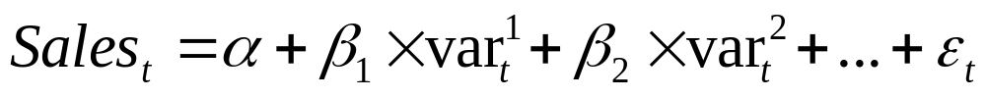
Factors that could drive sales
Advertising
TV
Radio
Print
Outdoor
Internet
Promotions
Sponsorships
Events
Price
Adv quality
Distribution
Merchandising
Competition
Seasonality
Weather
Economic
Demographic
Industry data
Sales
Notes:
Different variables are identified as possible factors that significantly drive sales. The selection of these variables depends on product type, industry and market characteristics. As an example, ice cream sales definitively show a seasonal pattern and may depend on temperature. FMCG could be heavily driven by promotional activities.
In general, here are some types of data to consider when developing the dataset:
Economic data. Employment and unemployment, discretionary income, inflation rates, gross domestic product, interest rates, energy costs, etc. An understanding of the effects of general economic variables is vital to building sound models.
Industry data. What are the trends in the specific industry? Is the market for the product or service growing? What is the rate of growth? Is international trade affecting the industry? Are important geographic differences evident within the industry?
Product category data. What are the trends in the specific product category? For example, is the refrigerated soy milk category growing? At what rate? How does this growth vary by geographic region? What are the trends by brand?
Product lines and SKUs (Stock Keeping Units). What is the history of each major brand within the category? What new products or new SKUs have been introduced, and when, for each major brand? What is the history of private label brands and SKUs in the category?
Pricing data. A history of average prices for each SKU in the category is essential. Pricing is almost always an important variable.
Distribution levels. What is the history of distribution levels for each product and SKU? What is the quality of that distribution? Average number of shelf facings per SKU?
Retail depletions. It’s essential to have a clean measure of sales to end-users, undistorted by fluctuations in inventories. Factory shipments are worthless for modeling purposes, in most instances. Retail take-away (or retail depletions) in dollars and in units (ounces, pounds, cases, etc.) is the most common measure of sales to consumers. The goal is to accurately measure sales to ultimate users (the people the marketing efforts are focused upon).
Advertising measures. Money spent on media advertising is seldom useful by itself. The media advertising must be translated into television GRP (gross rating point) equivalents, or some other common “currency.” That is, the print advertising, the radio advertising, the online advertising, etc. must all be converted into common units of measure (typically, television GRP equivalents). The money spent by specific media type (adjusted for comparative effectiveness) is another way of weighting media inputs as variables. All of this is apt to prove worthless, however, if copy-testing scores are not included for each of the ads. A media plan of 100 GRPs per week might have no effect if a weak commercial is run, but might have great effect if a terrific commercial is aired. Likewise, the exact media schedule is important, and the length of time each commercial is on the air must be considered because of wear-out effects.
Consumer promotion. Consumer (or end-user) promotions come in many forms, but the primary characteristic of these promotions (as compared to advertising) is the immediacy of the effects. Promotions are designed to have powerful, short-term effects on sales. Temporary price reductions, cents-off coupons, and buy one/get one free are examples of common consumer promotions. These promotions must be understood, measured, and incorporated into the models. If not fully comprehended, the promotion effects could easily overwhelm the modeling effort.
Trade promotion. These promotions usually take the form of discounts or allowances given to the trade in order to stage in-store promotions of some type (temporary price reductions, end-aisle displays, in-store signage, local advertising, and so on). Trade promotions must be fully understood and included within the models because of the sales fluctuations they cause. When the manufacturer offers one dollar off the price of each case for 30-days (a typical trade promotion), the retailer is very likely to take actions to increase sales of that brand.
Sales force effects. Every company and industry are different, but the nature and strength of a company’s sales force (and how it is organized, managed, and compensated) can create variables for the marketing models. Sales organizations tend to be very expensive, so it’s generally worthwhile to try to include sales force variables within the models.
Service effects. If services are an important part of the customer’s experience in buying and/or using a product, then this variable must be measured and incorporated into the models. For example, if a new product must be installed by a service technician, then the interaction between customer and technician can be a major variable, and must be tracked with some type of customer satisfaction survey

Slide 12
MMM project process
Set out objectives
Define scope
Discuss data availability
Design data-warehouse
Data preparation
Collect data
Validate, harmonize and consolidate data
Present exploratory analysis to client
Presentation
Interpretation of results
Learning and recommendations
Model development
Estimation
Diagnostics
Calculate ROIs, Price elasticity and response curves
Notes:
A MMM project starts with a workshop where client’s needs are identified and a corresponding solution is proposed by the quant team. Once the project’s scope is defined and agreed, the quant team requests the data necessary for the analysis. Usually the client provides restricted data such as sales, price, distribution, margins etc while media information and external factors are retrieved from research agencies or data providers.
Regardless of method, marketing mix modeling can be successful only if accurate and highly specific data are available upon which the modeling can be based. The greatest barrier to successful modelling is always a lack of relevant, specific, accurate data. So, the first step in any modeling effort is designing the data warehouse that will support the modelling. The next step is collecting and cleaning all of the historical data and entering it into the data warehouse, and then cleaning and entering new data on a continuing basis. Clean, accurate, highly specific data is absolutely essential to successful modeling. The data must be specific to individual brands and product lines, not the company as a whole.
Once the data warehouse is built, some exploratory analysis is conducted and presented to the client in order to validate the data and avoid possible mistakes. After data validation comes model estimation and calculation of ROIs, price elasticity and response curves.
The cycle ends with a final presentation describing and interpreting the output of the model and providing recommendations

Slide 13
Case study
An energy company SPetrol wants to evaluate the advertising investments of its retail business in the US from 2001 until 2004.
Client’s questions:
  How much have we made through advertising?
  What is the return on investments of our media activities?
  Which marketing drivers have had the greatest effect?
  What’s the influence of price on our sales?
  Are we optimally allocating our budget across products ?
Notes:
Discussion. Go trough project cycle and brainstorm next steps.

Slide 14
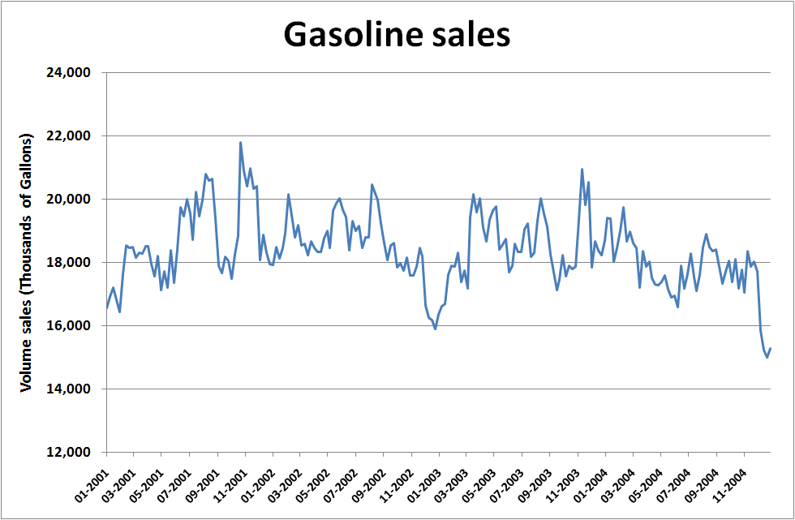
Target variable
Notes:
4 years of volume sales data are simulated. In this example data is aggregated at national level i.e. Total sales in the USA. However, it is always preferable to collect data by region or city or even better by sale place. In this case, volume sales by petrol station and fuel type would be the most granular data level. For Fast Moving Consumer Goods sales time series are usually available at SKU(Stock Keeping Unit) level. SKU is a unique identifier for each distinct product and service that can be purchased.
In most of the cases, time series of volume, price and distribution are made available directly by the client.

Slide 15
Advertising data
The performance of TV and radio advertising is expressed in terms of Gross Rating Points (GRPs) . A rating point is a percentage of the potential audience and GRPs measure the total of all rating points during and advertising campaign.
  GRPs (%) = Reach * Frequency
  Example: Let’s assume a commercial is broadcasted two times on TV
1st time on air
25% of target televisions are tuned in
2st time on air
32% of target televisions are tuned in
GRPs
57%
Notes:
For the TV advertising activity, it is possible to examine how each ad execution has performed in the market in terms of its impact on sales volume. TV and radio advertising data are ion terms of Gross Rating Points (GRPs)
Gross Rating Points (GRPs) equal Reach times Frequency, expressed as a percentage.
GRPs measure the total of all Rating Points during an advertising campaign. A Rating Point is one percent of the potential audience. For example, if 25 percent of all targeted televisions are tuned a show that contains your commercial, you have 25 Rating Points.
If, the next time the show is on the air, 32 percent are tuned in, you have a total of 25 + 32 = 57, and so on through the campaign. The word "gross" reflects that the calculation double-counts (actually multiple-counts) the audience; that is to say, it is possible to reach a percentage higher than 100.
Gross Rating Points could also be applied to other media besides television: radio, print, billboards, the web, and so on. If you attach a United Way banner to your corporate headquarters building, and 3 percent of your target population drives by the billboard twice every day for 120 days, then GRPs = 3 x 2 x 120 = 720.
Media planners calculate total Reach, average Frequency, and GRPs as part of the planning of a campaign. The goal is to obtain the highest possible GRPs at the lowest possible cost, while remaining focused on the target market. After the campaign, you can calculate actual Reach x Frequency = GRPs to produce a permanent record.

Slide 16
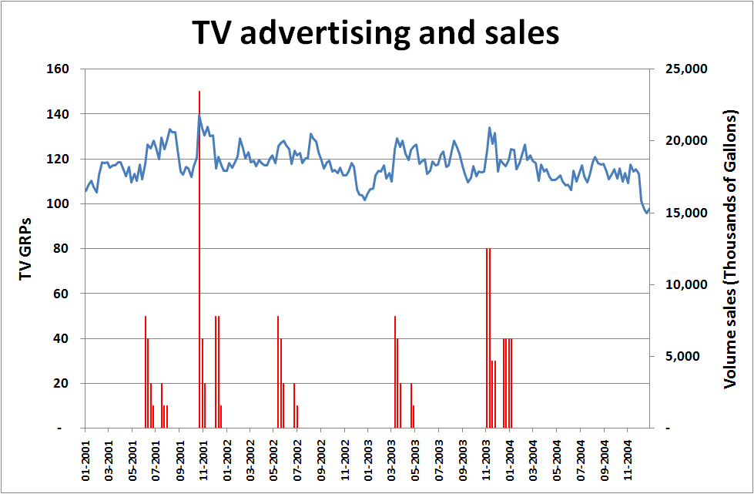
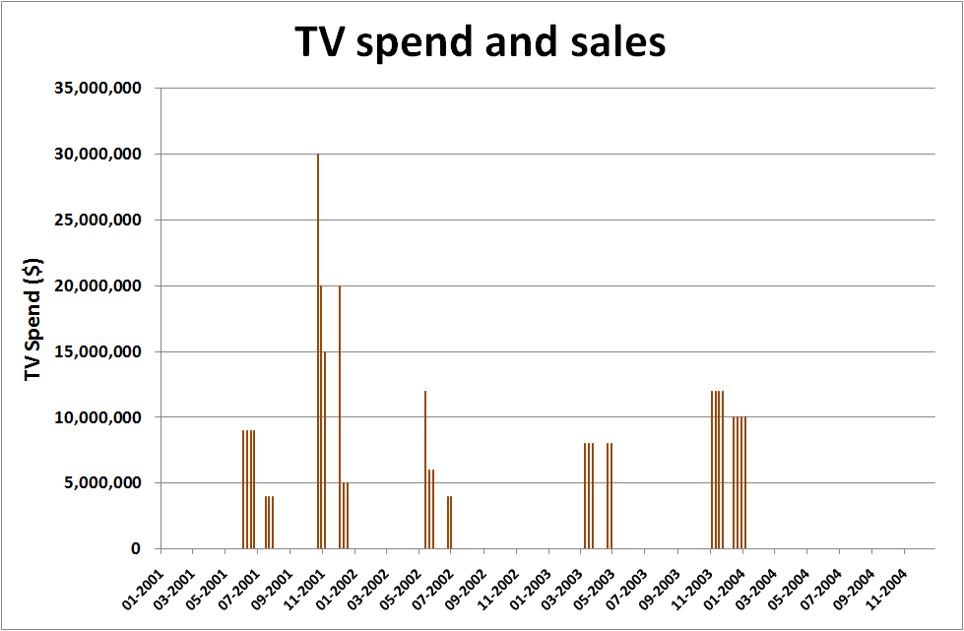
Advertising data
Spetrol has deployed 5 TV campaigns over the sample with a total expenditure of 300 million $
Each campaign lasted from 4 to 8 weeks
Is there any relationship between sales and TV advertising?
Notes:
TV, radio and online time series are displayed in terms of GRPs alongside with their corresponding cost. For media such as OOH, only weekly spend is available.

Slide 17
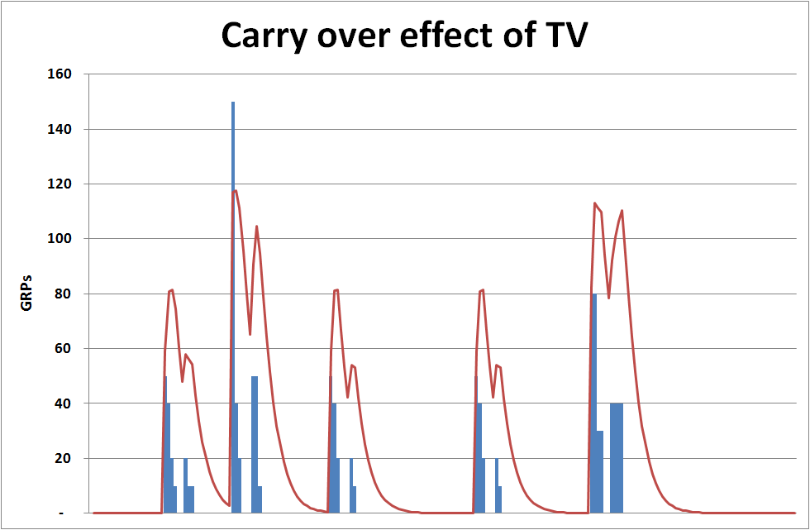
Carry over effect of TV
Notes:
Carry over effect – AdStock transformation allows the inclusion of lagged and non linear effects.
Television advertising is one of the largest investments. TV advertising has both dynamic and diminishing returns its affects extends some periods following the original exposure. This behaviour is generally referred as advertising carry over effect or Adstock

Slide 18
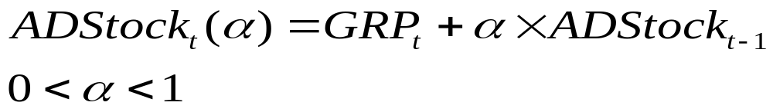
Carry over effect of TV
The exposure to TV advertising builds awareness, resulting in sales.
ADStock allows the inclusion of lagged and non linear effects
Alpha is estimated iteratively using least squares. The estimate is then validated by media planners
Notes:
The underlying theory of Adstock is that exposure to Television Advertising
builds awareness in consumer markets, resulting in sales. Each new
exposure to advertising increases awareness to a new level and this
awareness will be higher if there have been recent exposures and lower if
there have not been. This is the decay effect of Adstock and this decay
eventually reduces awareness to its base level, unless or until this decay is
reduced by new exposures.
This decay effect can be mathematically modelled and is usually
expressed in terms of the ‘half-life’ of the advertising. Adstock half-life can be estimated through a distributed lag model
response with lags of the TV Gross Ratings Point (GRP) variable, using
Least Squares, or from the lag parameter in the Adstock formulation
(geometric lag), or indirectly using a ‘t-ratio’ method by recursively testing
different values for the decay parameter through an iterative process with
sales panel data or awareness/image tracking data against the
corresponding advertising schedules (Fry, Broadbent, Dixon 1999).
Below is a simple formulation of the basic Adstock model of Broadbent
(1979):
At = Tt + At-1 t=1,…., n (2)
Where At is the Adstock at time t, Tt is the value of the advertising variable at
time t and is the ‘decay’ or lag weight parameter. Inclusion of the At-1 term,
5
imparts an infinite lag structure to this model, with the effect of the first
Adstock term, approaching 0, as t tends to .
This is a simple decay model, because it captures only the dynamic effect of
advertising, not the diminishing returns effect.
This model is also approximately equivalent to an infinite distributed lag
model as shown below:
From (1) we have, At = Tt + At-1
Recursively substituting and expanding we have,
At = Tt + Tt-1 + 2Tt-2 +… nTt-n (3)
Since is normally less than 1, n will tend to 0 in limit as n tends to .
Therefore, this infinite polynomial distributed lag can be approximated by
imposing a finite lag structure within an Almon distributed lag model (Almon
1965).
Adstock transformation is an efficient and effective technique to incorporate
nonlinear and dynamic advertising effects in sales response models. The
alternative option of building a dynamic nonlinear model is both
computationally expensive and complex to estimate.

Slide 19
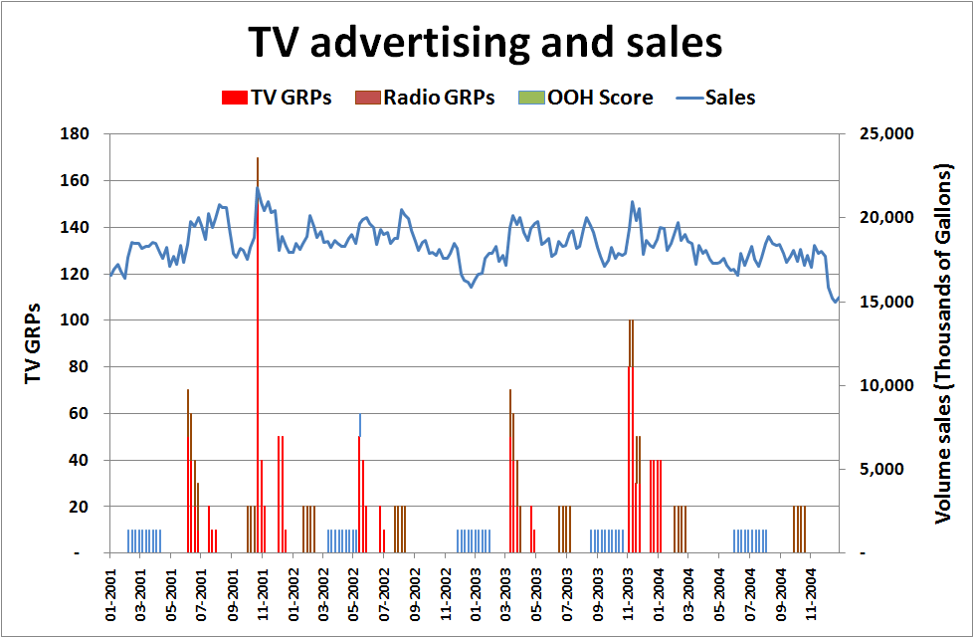
Advertising data
300 M
TV Spend
164 M Radio
160 M
Outdoor
Notes:
An investment of 300 million $ in TV, 164 million $ in radio and 160 million $ in outdoor generated the Gross Rating Points displayed on the chart. The campaigns are distributed over the 4 years. Radio and TV often overlap to enhance the reach of target audience.

Slide 20
Below the line promotions
It may include
  sponsorship
  product placement
  sales promotion
  merchandising
  trade shows
Usually represented by dummies (variables equal to 1 when a promotion takes place and 0 otherwise)
Notes:
Trade promotion is a key activity in every marketing plan. It is aimed at increasing sales in the short term by employing promotion schemes which effectively increases the customer awareness of the business and its products. The response of consumers to trade promotions is not straight forward and is the subject of much debate. Non-linear models exist to simulate the response. Using MMM we can understand the impact of trade promotion at generating incremental volumes. It is possible to obtain an estimate of the volume generated per promotion event in each of the different retail outlets by region.
Sponsorship is a cash and/or in-kind fee paid to a property (typically in sports, arts, entertainment or causes) in return for access to the exploitable commercial potential associated with that property. For example, a corporate entity may provide equipment for a famous athlete or sports team in exchange for brand recognition. The sponsor earns popularity this way while the sponsored can earn a lot of money. A particular form of specialized brand sponsorship where a brand sponsors an unusual event or pastime that then becomes synonymous with that brand (to the point where future brands may be excluded from participation) is known as 'aboutsponsorship'. This provides a strong walled-garden sponsorship relationship between particular events and the brand

Slide 21
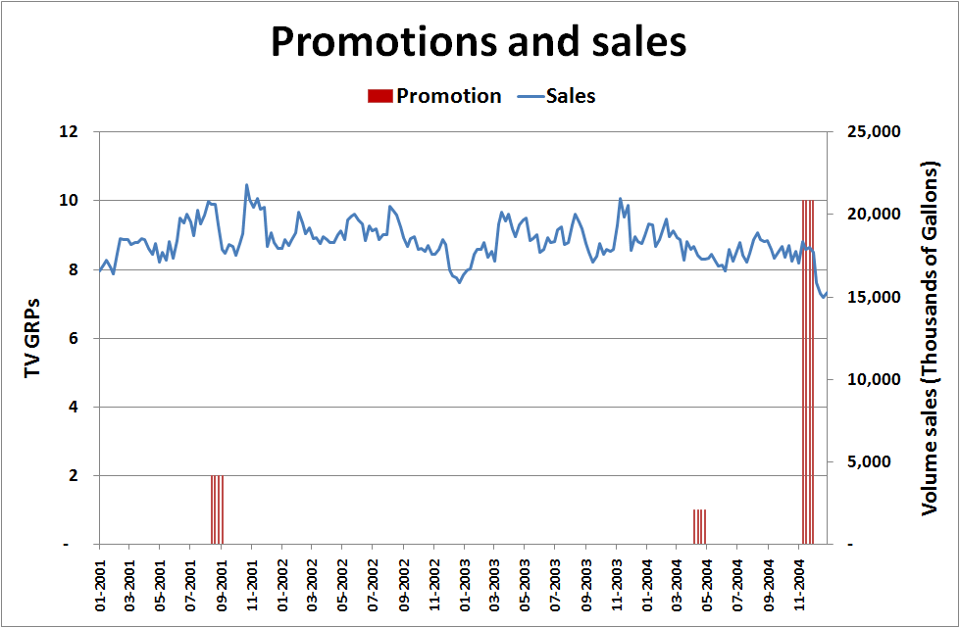
Below the line promotions
Sponsorship
World Rally Championship
Sale promotion
Sale promotion
5% Discountt
Notes:
What’s the short term effect of promotional activities on sales?

Slide 22
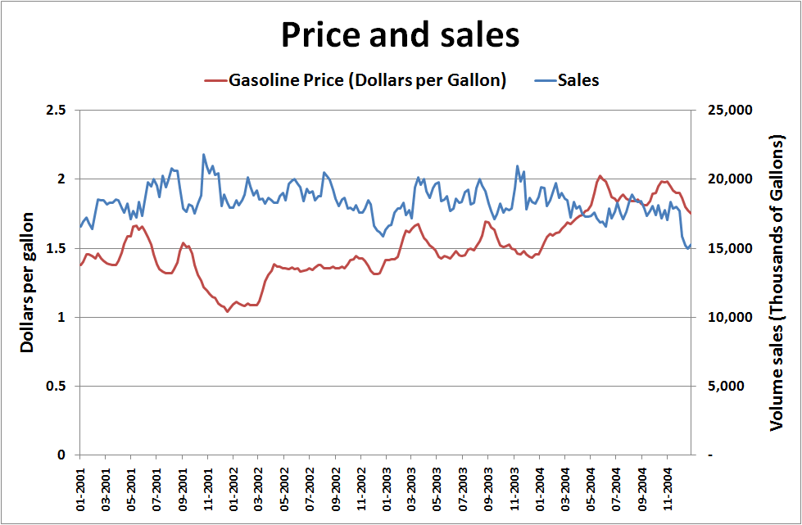
Price
Notes:
In general, price changes of the brand impacts sales negatively. This effect can be captured through modeling the price in MMM. The model provides the price elasticity of the brand which tells us the percentage change in the sales for each percentage change in price.

Slide 23
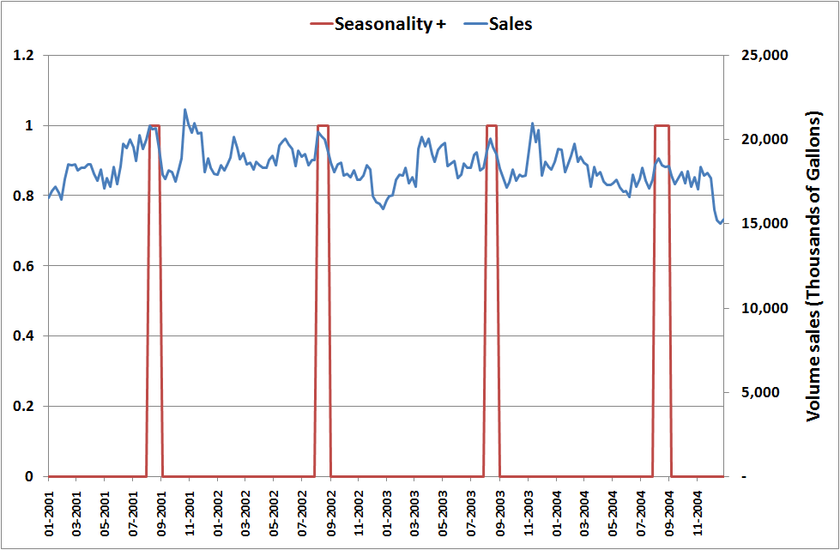
Seasonality
Sale promotion
5% Discountt
August seasonal dummy
Peaks every year
in August
Notes:
In statistics, many time series exhibit cyclic variation known as seasonality, periodic variation, or periodic fluctuations. For example, retail sales tend to peak for the Christmas season and then decline after the holidays. So time series of retail sales will typically show increasing sales from September through December and declining sales in January and February.
Detecting seasonality
Visual inspection of chart
A run sequence plot will often show seasonality
A seasonal subseries plot is a specialized technique for showing seasonality
Multiple box plots can be used as an alternative to the seasonal subseries plot to detect seasonality
The autocorrelation plot can help identify seasonality
Seasonal Index measures how much the average for a particular period tends to be above (or below) the expected value
Modeling seasonality
A completely regular cyclic variation in a time series might be dealt with in time series analysis by using a sinusoidal model with one or more sinusoids whose period-lengths may be known or unknown depending on the context.
An alternative approach to model seasonality consists in using SARIMA models
Seasonality can also be estimated by inserting seasonal dummies as explanatory variables of the model i.e. variables equal to one ever second week of the year and zero othervise

Slide 24
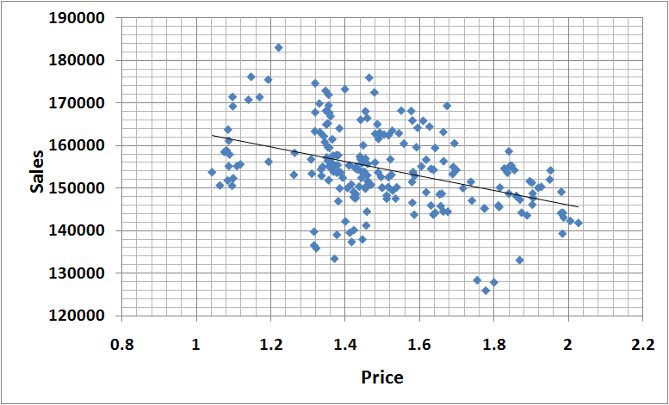
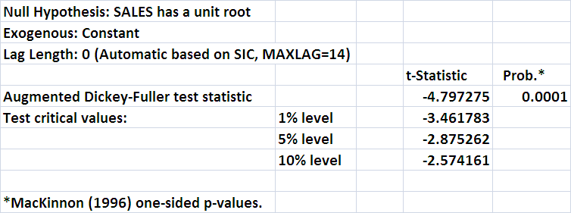
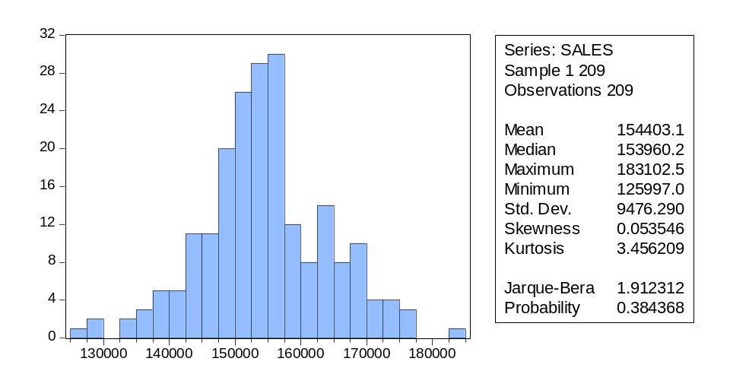
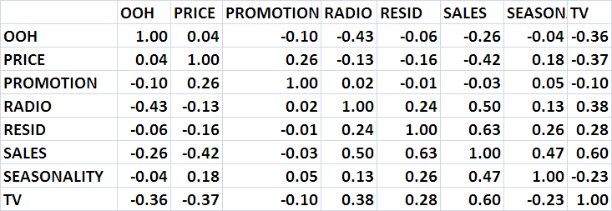
Exploratory analysis
Scatter plot
Unit root test
Histogram and desc stats
Correlation matrix
Notes:
Exploratory analysis includes a variety of statistical methods to gain further information that can’t be easily inferred by merely looking at time series charts. It is used to check and validate the data and to discover some information for model development. For example, from the scatter plot it can be inferred that price and sales are related. In addition, the correlation matrix displays that TV is positively correlated with sales. Thus, the modeller would then proceed by regressing TV and Price on sales expecting a positive coefficient from the former factor and a negative coefficient from the latter.
The slide shows only a few examples of exploratory techniques:
The Scatter plot shows e negative liner relation between sales and price i.e. to higher values of price correspond to lower values of sales
Unit root test (Augmented Dickey-Fuller stat is used to test whether sales can be modelled with a autoregressive model with a unit root (y(t)=1*y(t-1) + ...+ e). If so, the dependent variable is a unit root process and the model could produce unreliable results (spurious regressions). In this example, the hypothesis of a unit root is rejected at 1% significance level (prob. = 0.0001 < 0.01) i.e. Sales is not a unit root process
Histogram and descriptive statistics histogram is a graphical display of frequencies. It is useful to identify the distribution of a variable. In this examples, sales seems to be distributed according to a normal. The supposition is confirmed by the Jarque-Bera stat for which the hypothesis of normality cant be rejected at 5% significance level (Probability = 0.3843 > 0.05)
Correlation matrix displays all the correlations among variables. It is useful to identify collinearity between explanatory variables of the model (see model diagnostics)
Before staring to develop the multivariate regression, it is important to have a clear understanding of the form and quality of the data. The form of the data refers to whether the data are nonmetric or metric. The quality of the data refers to how normally distributed the data are. The first few techniques discussed are sensitive to the linearity, normality, and equal variance assumptions of the data. Examinations of distribution, skewness, and kurtosis are helpful in examining distribution. Also, it is important to understand the magnitude of missing values in observations and to determine whether to ignore them or impute values to the missing observations. Another data quality measure is outliers, and it is important to determine whether the outliers should be removed. If they are kept, they may cause a distortion to the data; if they are eliminated, they may help with the assumptions of normality. The key is to attempt to understand what the outliers represent.

Slide 25
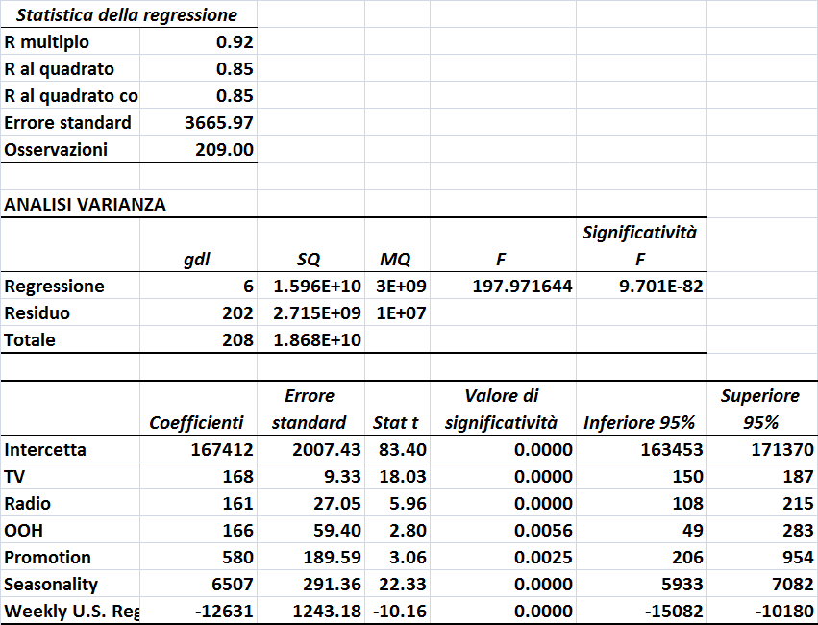
Model development
Notes:
Different combinations of factors are iteratively tested until a final equation is chosen. The best model is selected according to both qualitative and quantitative criteria.
A qualitative criterion is merely common sense from a business and economic standpoint (coefficients signs). For example, e negative coefficient for price would be a red flag unless there is a logic reason for it. A deep knowledge of product, brand, industry and media planning is key to evaluate the validity of a model. Media planners often are aware of the most successful campaigns and would expect the model to reflect their a priori information
Quantitative criteria are:
-Rsquared – it varies from 0 to 1 and is a measure of fit of the model. The higher is the Rsquare the better is the fit. By itself, a very high Rsquared doesn’t necessary imply that the model is good. It has to be evaluated in combination of other statistics and qualitative criteria. Rsquared can be misleading when working on level data since usually the intercept takes on the majority of the variation and pushes the Rsquare up.
-Fstat – a pvalue of the Fstat below 5% means that the equation is statistically significant at 5% confidence level i.e. The hypothesis of the estimated coefficients to be all equal to 0 is rejected at 5% confidence level
-Tstat/pvalue the pvalue of every factor must be lower than 5% which means that the coefficients are statistically different from 0

Slide 26
Estimated equation
Salest = 167412 +
168* AdStock(GRPsTVt,0.75) +
161* AdStock(GRPsRadiot,0.35) +
166* AdStock(Outdoort,0.15) +
580* PromotionDummyt +
6507* Seasonalityt +
-12631* Pricet + Errort

Slide 27
Model diagnostics
Model:
  Significant F-stat and high R-squared
Variables:
  Significant T-stats
  Coefficients must make sense
  Variance inflation factor low
Residuals:
  Normality (Jarque-Bera)
  Absence of serial correlation ( Durbin Watson, correlogram)
Notes:
The Variance Inflation Factor quantifies the severity of multicollinearity in a linear regression. High multivollinearity must be avoided since it produces wrong coefficients and tstats.
It is calculated for each explanatory variable. To calculate a VIF for an explanatory variable Xi, run an ordinary least square regression that has Xi as a function of all the other explanatory variables in the first equation. Then, calculate the VIF factor for with the following formula 1/(1-R^2) where R^2 is the Rsquared of the regression. This procedure is repeated for each explanatory factor. A VIF greater than 3 signals high multicollinearity.

Slide 28
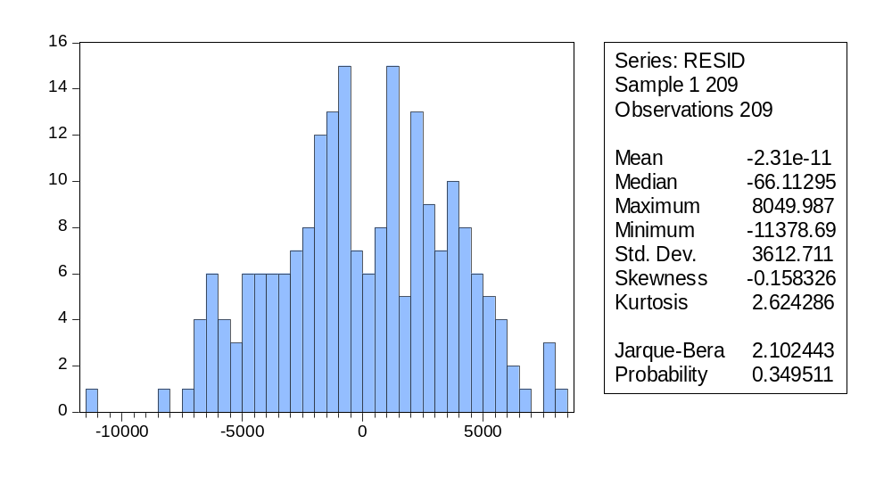
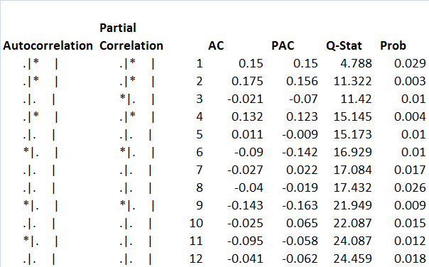
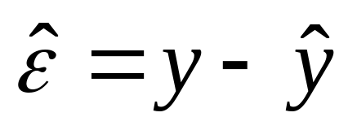
Residuals diagnostics
Durbin Watson = 1.69
DW>2 positive autocorrelation
DW<2 negative autocorrelation
Notes:
The linerar regression inference is based on the assumption for residuals (actual sales minus estimated sales) to be independent and identically distributed according to a normal. Thus, the property of normality and the absence of serial correlation of the residuals must be checked.
Jarque-Bera stat the assumption of normality can’t be rejected at 5% confidence level. However, the Durbin Watson stat (used to detect the presence of autocorrelation in the residuals) signals some weak positive autocorrelation in the residuals confirmed by the correllogram.

Slide 29
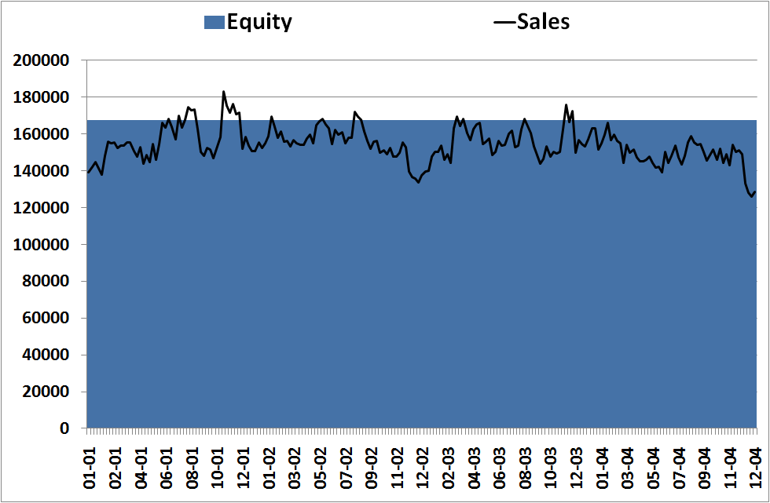
Estimated factors contribution to sales
Fitted Salest = estimated Intercept = 167,412
Can be interpreted as Brand Equity:
  Volume generated in absence of any marketing activity
  Indicator of the strength of the brand and users’ loyalty
Notes:
Equity or Base
The very break-up of sales volume into base (volume that would be generated in absence of any marketing activity) and incremental (volume generated by marketing activities in the short run) across time gain gives wonderful insights. The base grows or declines across longer periods of time while the activities generating the incremental volume in the short run also impact the base volume in the long run. The variation in the base volume is a good indicator of the strength of the brand and the loyalty it commands from its users
Brand equity refers to the marketing effects or outcomes that accrue to a product with its brand name compared with those that would accrue if the same product did not have the brand name. And, at the root of these marketing effects is consumers' knowledge. In other words, consumers' knowledge about a brand makes manufacturers/advertisers respond differently or adopt appropriately adept measures for the marketing of the brand. The study of brand equity is increasingly popular as some marketing researchers have concluded that brands are one of the most valuable assets that a company has. Brand equity is one of the factors which can increase the financial value of a brand to the brand owner, although not the only one.

Slide 30
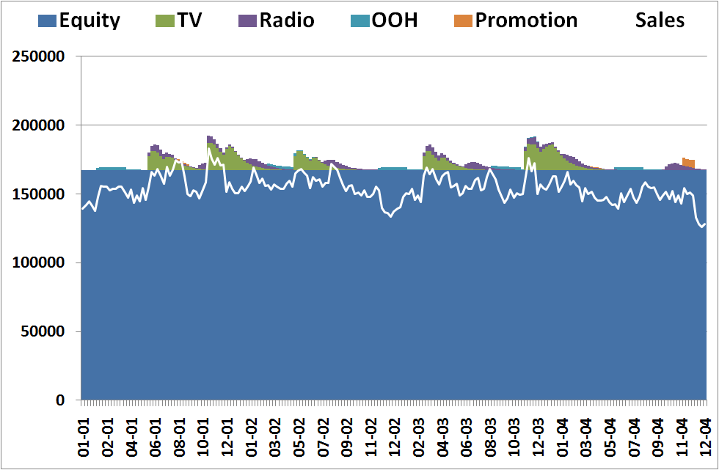
Estimated factors contribution to sales
TV Contributiont(000’ Gallons) = coefficient *Adstock(TV)t
Fitted Salest = 167,412 + 168* TVt + 161*Radiot +
166* OOHt + 580* Promotiont

Slide 31
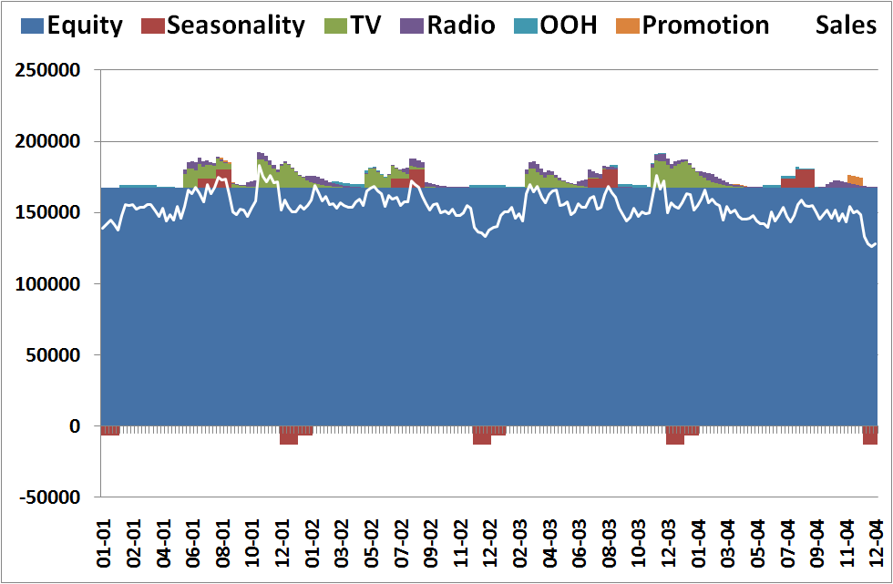
Estimated factors contribution to sales
Peacks every year
in August
Peaks every year
in August
Fitted Salest = 167,412 + 168* TVt + 161*Radiot +
166* OOHt + 580* Promotiont + 6507* Seasonailityt
Equity = estimated Intercept = 167,412
Can be interpreted as Brand Equity

Slide 32
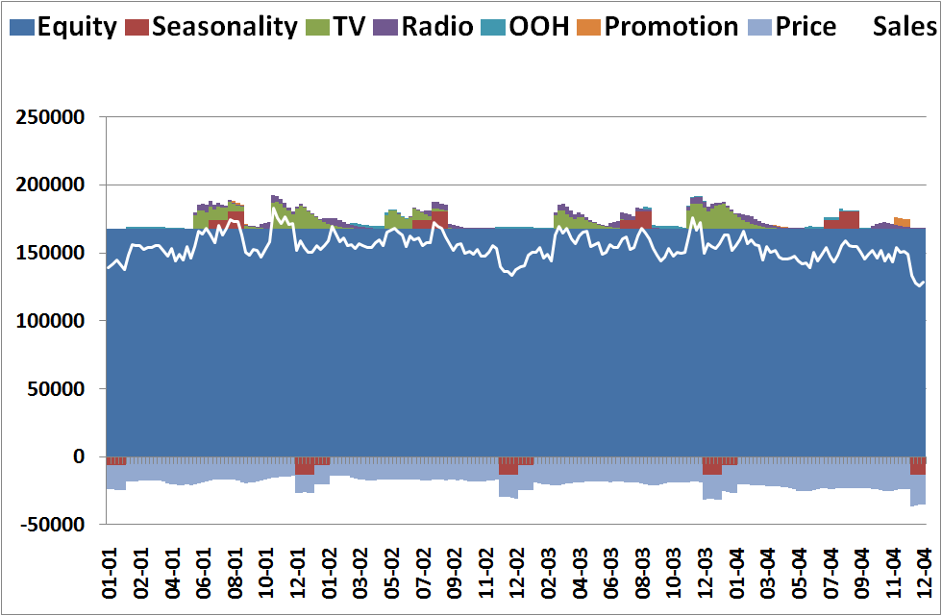
Estimated factors contribution to sales
Fitted Salest = 167,412 + 168* TVt + 161*Radiot +
166* OOHt + 580* Promotiont + 6507* Seasonailityt - 12631* Pricet
Negative price effect

Slide 33
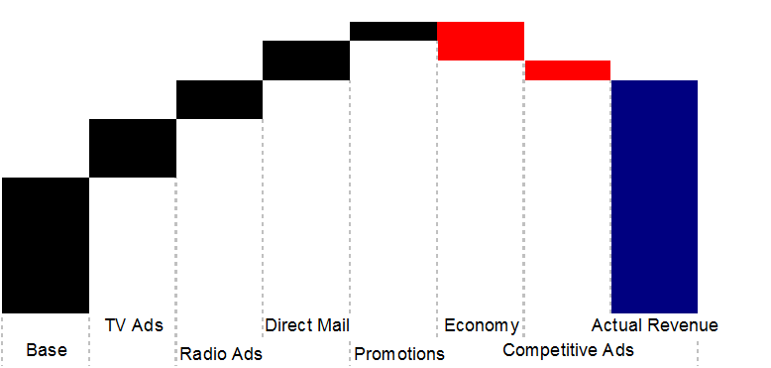
Marketing mix (sample output)
Notes:
Above is an alternative way of breaking up sales into the factors estimated by the model

Slide 34
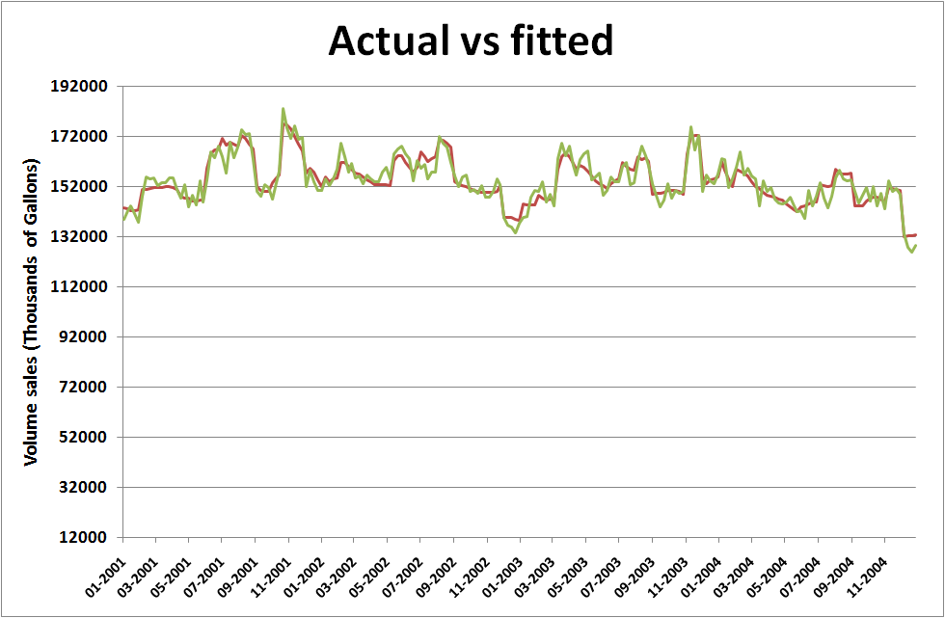
Estimated factors contribution to sales
Notes:
Acual sales vs sales forcasted by the model. A visual way to assess the goodness of fit of the regression

Slide 35
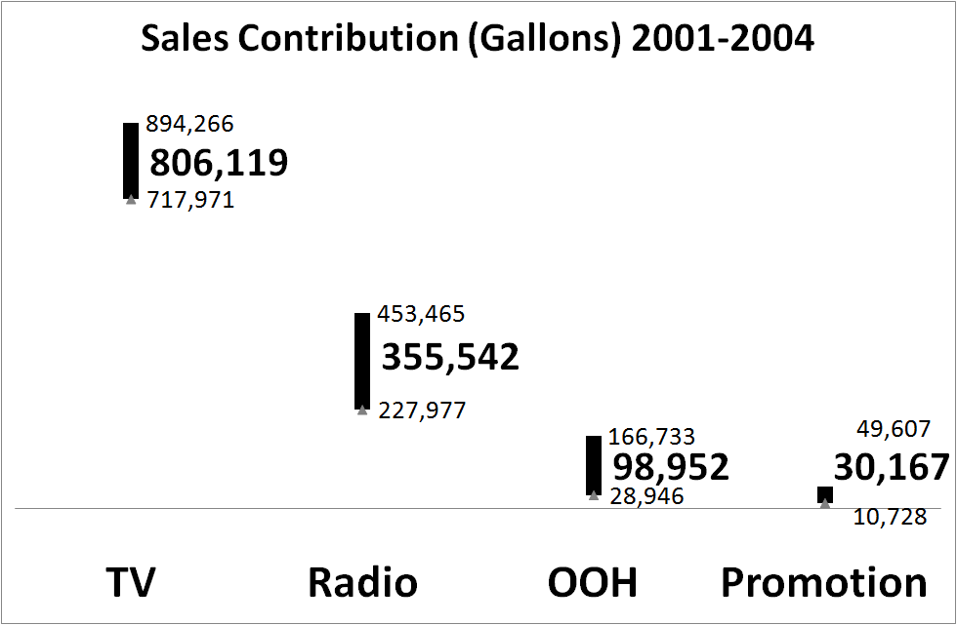
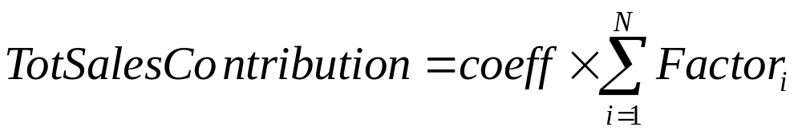
Estimated factors contribution to sales
Notes:
The sum of TV GRPs across the four years is 4792. By multiplying 4792 by the regression coefficient of TV (168) we get 806,119 which represents the number of gallons sold thanks to TV advertising.

Slide 36
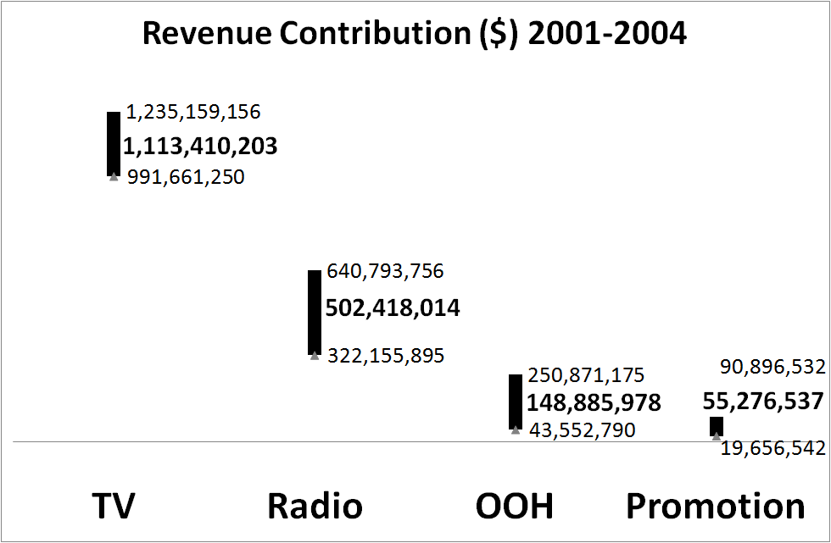
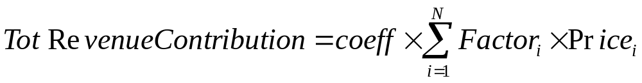
Estimated factors contribution to revenue

Slide 37
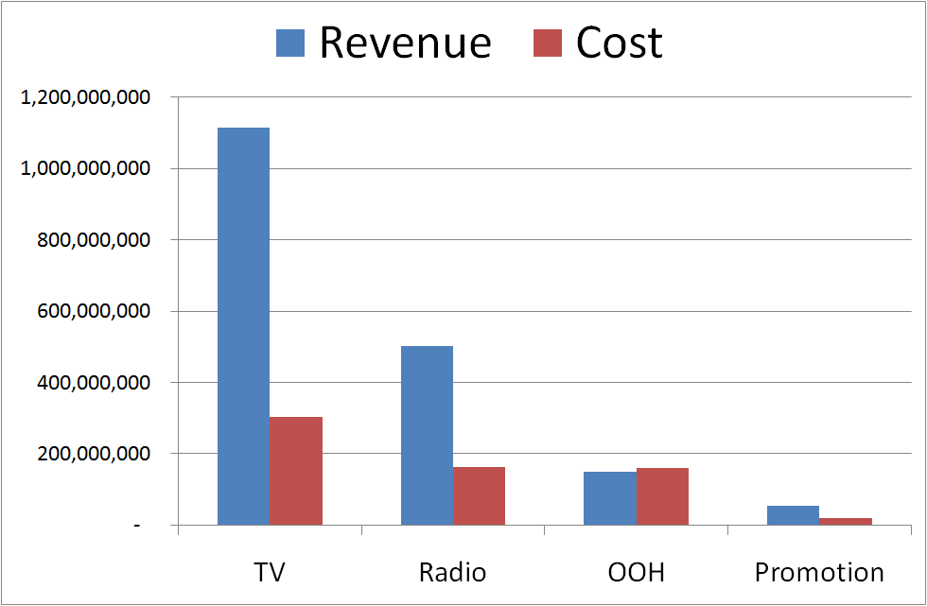
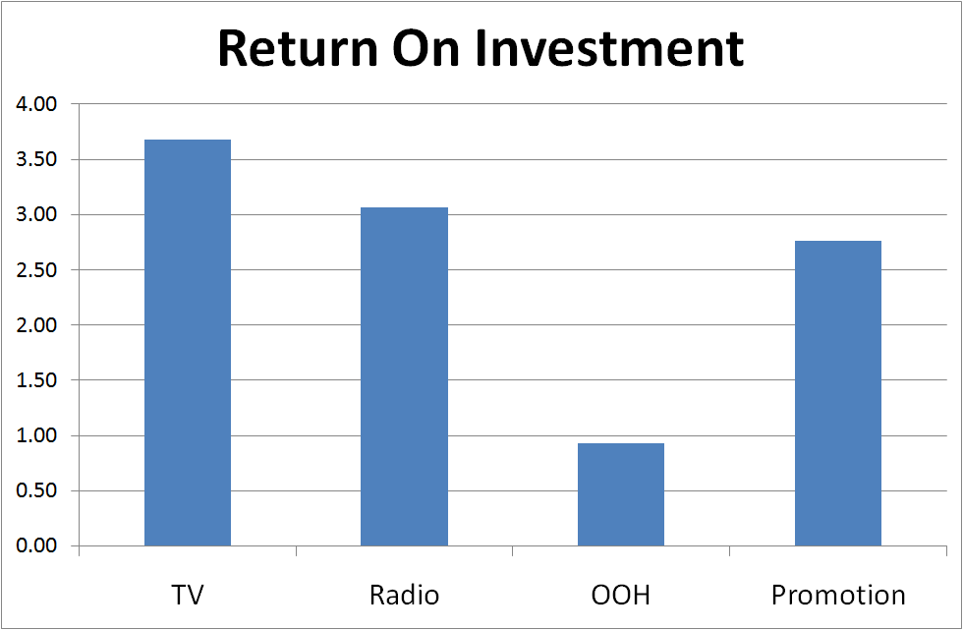
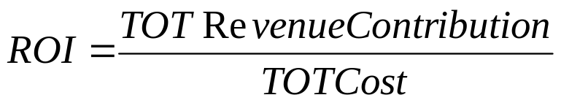
ROI

Slide 38
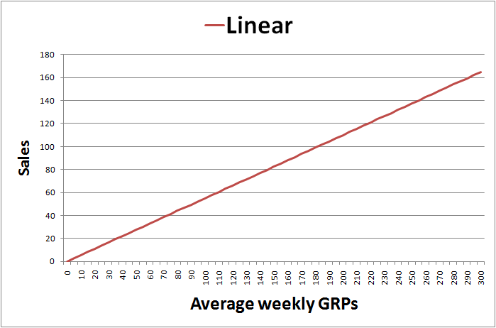
Does it really make sense?
The more I invest in media, the more I sell
Diminishing returns

Slide 39
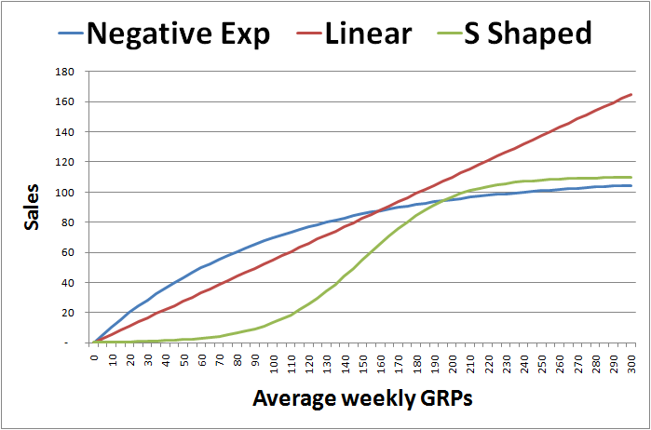
Response curves
Taking into account diminishing returns
Notes:
The model is linear in parameter but can account for non linearity though variable transformations.
Advertising can also have diminishing returns to scale or in other words
the relationship between advertising and demand can be nonlinear. For
example, the effect of 200 GRPs of advertising in a week on demand for a
brand maybe less than twice that achieved with 100 GRPs of advertising.
Typically, each incremental amount of advertising causes a progressively
lesser effect on demand increase. This is a result of advertising saturation.
The usual approach to account for saturation is to transform the
advertising variable to a non-linear scale for example log or negative
exponential transformations. It is this transformed variable that is used in
the sales response models.
Tt can be transformed to an appropriate nonlinear form like the logistic or
negative exponential distribution, depending upon the type of diminishing
returns or ‘saturation’ effect the response function is believed to follow.
For example if advertising awareness followed a logarithmic distribution,
then in a linear sales response model we would have:
ST = Log (TT) + T (1)
Where ST is sales at time T, TT is the level of advertising GRPs at time T
and T is the random error component. In this case for 100 GRPs and
assuming =1, the sales effect of advertising would be 4.6 units and for
200 GRPs the sales effect would be 5.3 units. Therefore, for a 100%
increase in advertising we would only have a 15% increase in sales.
Advertising typically has a lower elasticity than other elements of the
marketing-mix. This is considered acceptable by Brand Managers since
advertising is also believed to have a long-term positive effect on Brand
Equity, which is usually not captured by most econometric models.
Several versions of Adstock transformation are applied in the industry, we
will examine some popular models in the following sections.
2.3. Negative Exponential Decay Model
The below formulation applies a negative exponential distribution to the basic
Adstock formula, using two parameters, the ‘decay’ or lag weight parameter
and the learning rate or saturation parameter .
At = 1-e (- Tt) + At-1 (5)
This model is comparatively more flexible as different values of the parameter
can be empirically tested in a response model to correctly measure the level
of current advertising saturation.
2.4. Logistic (S-Curve) Decay Model
Using a logistic distribution instead of negative exponential will impart an Sshape
to the Adstock variable, implying an inflexion point or ‘threshold’ level
6
of GRPs before diminishing returns set in. Below this threshold, the logistic
function imparts exponential returns.
At = 1/ (1+e (- Tt)) + At-1 (6)
As in the negative exponential model, the parameter can be used to model
different saturation levels.

Slide 40
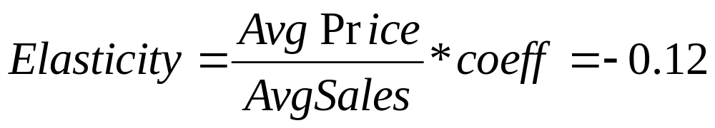
Price elasticity
Assumption: constant elasticity across the sample which implies a linear relation between volume and price
By using the coefficient of the regression, it is possible to derive an estimate for price elasticity:
  Price coefficient = -12631
  Average price = 1.51 $
  Average volume sales = 154,000 Gallons
A 10% drop in price increases sales by 1.2%

Slide 41
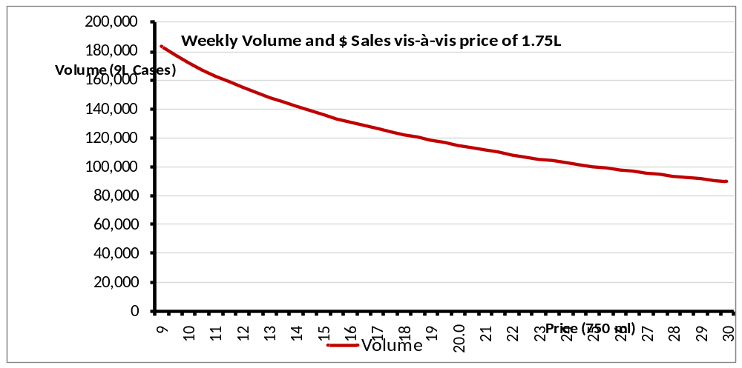
Dynamic price elasticity
Elasticity changes with price
Estimated through non linear regressions
Elastic (>1): Demand is sensitive to price changes.
Inelastic (<1): Demand is not sensitive to price changes

Slide 42
Client’s questions
How much have we made through advertising?
    1 billion $ driven by TV
    500 million $ due to radio
    200 million $ generated by Outdoor and promotional activities
  Investments in media generated 1.7 billion $ in revenue
Notes:
Marketingpower.com

Slide 43
Client’s questions
What is the return on investments of our media activities?
For each dollar invested in TV you get 3.5 dollars back

Slide 44
Client’s questions
What’s the influence of price on our sales?
A 10% drop in price increases sales by 1.2%
Notes:
Marketingpower.com

Slide 45
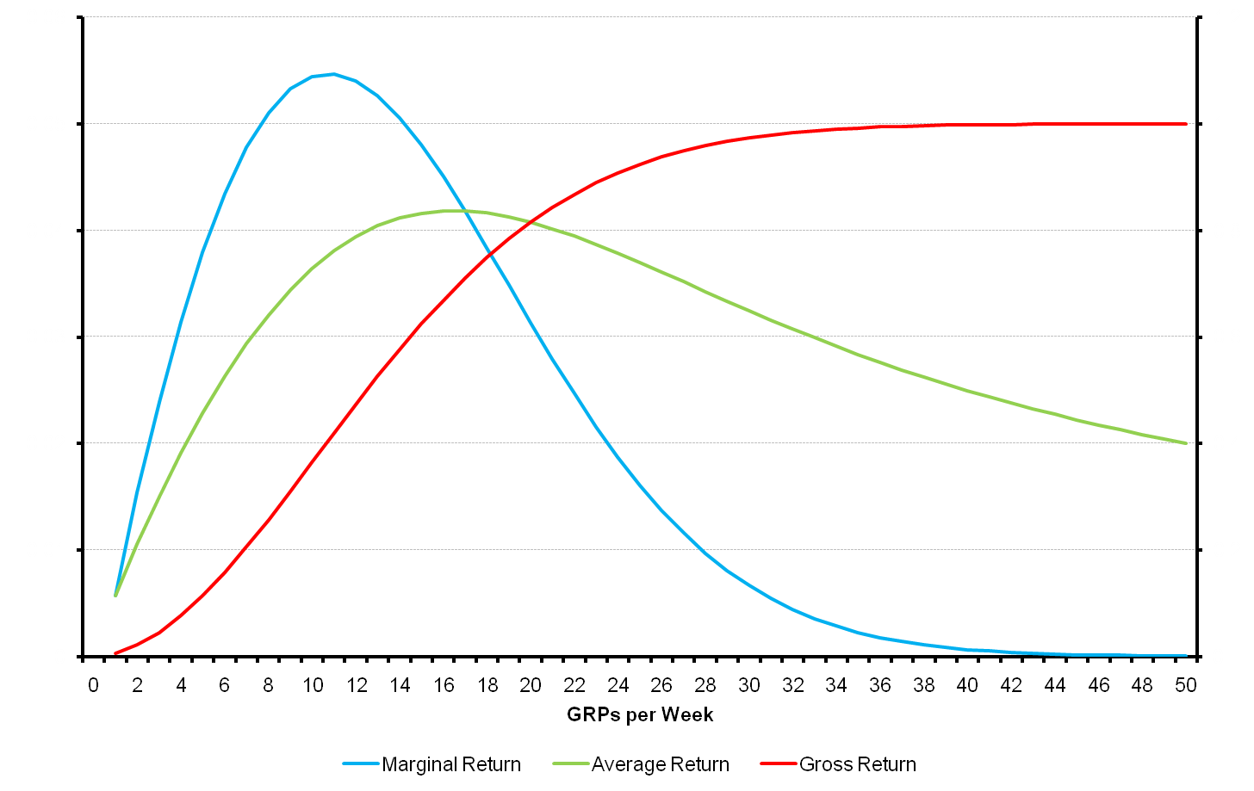
Are we optimally allocating our budget across products ?
Maximum Marginal Return
Optimal GRPs
Over Optimal GRPs
Point of Saturation
Sub –Optimal GRPs
Maximum Average Return
Invest more in Radio and less in OOH

Slide 46
Marketing mix (sample output)
Marketing Mix – Sample Output
45
Carry Over Effect
5000
Diminishing Returns
40
4500
35
4000
Promo TV Saturation
30
3500
25
3000
Weekly GRPs
Weekly Sales
Current
20
2500
Optimal
15
2000
1500
10
1000
5
500
0
Diminishing Returns is the point were spending additional GRPs does not results in additional sales.
Carry Over Effect (Ad Stock) relates to the residual effect of an ad.
When all the components are layered on Base sales, it is clear what drivers contribute to sales and when and their Simultaneous Effect.
0
0
20
40
60
80
100
120
140
160
180
Week1
Week2
Week3
Week4
Week5
Avg. Weekly GRPs
Simultaneous Effect
Volume
Base/Seasonal
TV/Radio/Print
Direct Marketing
Rates/Promotions
Time
Notes:
A sample output taken from the web
Not for copy or distribution without written permission from Lenskold Group

Slide 47
Pros and cons
Simple and intuitive
The outcome is backed by qualitative expertise and in field research
Constructive way of running different scenarios and evaluating past performance
Better with granular data
Very successful method – high turnover
Correlation doesn’t imply causality
Risk of spurious regressions especially when modelling in levels
Model highly depends on variables chosen
Poor in forecasting
Notes:
Here are some of the problems with econometric marketing mix modelling:
Firstly, such statistical modelling works on variation in the dependent variable (eg sales or share) and the independent variables (advertising spend or SoV or exposures, pricing, media strategy, timing, point of sale, sales team emphasis etc). But very often there is little in the way of variation, especially in the dependent variable. Big established brands show little sales reaction to changes in advertising
Secondly this modelling of variation assumes that correlations imply causality. And we all know that is very often not the case. Both sales and advertising spend go up at Christmas but it doesn't mean the advertising is causing (some ? all ? any ?) of the sales increase. And sales increases can cause advertising increases, as well as the other way round.
Thirdly there is the (subjective art) of what to include in the model and what to leave out. Typically advertising spend and price are included as potential drivers of sales, but what about competitors' advertising and prices ? And what about point of sale ? And numbers of merchandisers and sales people ? And trade promotions ? And publicity levels ? And product placements ? And allowance for media strategy ? And creativity and branding execution ? And new variant/product/brand launches - ours and competitors ? And seasonality ? And what's going on in other categories - complementary and competitive ?

Slide 48
Spurious statistics
A high correlation between sales and TV could mean:
  Either media causes sales
  or sales causes media
  or a third variable causes both sales and TV
Sales
Media
Income
What is the truth?
Notes:
An example of a spurious relationship can be illuminated examining a city's ice cream sales. These sales are highest when the rate of drownings in city swimming pools is highest. To allege that ice cream sales cause drowning, or vice-versa, would be to imply a spurious relationship between the two. In reality, a heat wave may have caused both. The heat wave is an example of a hidden or unseen variable.
Example in excel file.

Slide 49
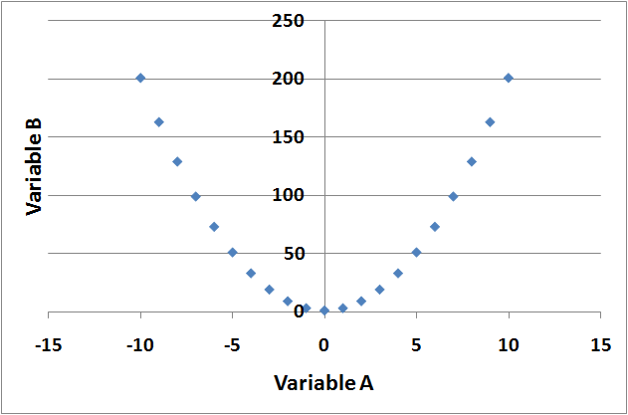
Non sense correlations
Some spurious correlations:
  death rate and proportion of marriages Corr = 0.95
  National income and sunspots Corr = 0.91
  Inflation rate and accumulation of annual rainfall
On the other hand, a low correlation doesn’t rule out the possibility of a strong relation:
Corr = 0.0
Correlations must support a theory
Calculate correlations both in levels and differences
Always look at scatter plots
Notes:
Correlation and linear regression coefficients must be interpreted with care. Statistical significance doesn’t imply that a meaningful relationship has been found. There must be a theory about the joint variation of two variables and the correlation coefficient may support or deny that theory, but if no theory exists, the correlation may be classed as non sense correlation
The three correlations above are high because the variables are subjects to trend movements over time. Cumulative sunspots and cumulative rainfall necessarily trend upwards like inflation rate and national income. Once the variables are diffeenciated (diff = y(t)-y(t-1)) correlations become negligible.

Slide 50

What variables should have been included?

Slide 51
New media
Digital Marketing
  Display Marketing
  Search Engine Marketing (SEO & PPC)
  Affiliate Marketing
  Mobile Marketing
  Social Media
Notes:
Digital Marketing is the promoting of brands, products and services using interactive channels to reach users in a timely, relevant, personal and cost-effective manner’
Display M. ‘Paid ad placements using graphical or rich media ad units within a web page to achieve goals of delivering brand awareness, familiarity, favorability and purchase intent’
‘Search Marketing is about using Internet Search Engines and Directories to deliver targeted traffic to web sites. It is a blend of two core techniques: Search Engine Optimisation (SEO) and Paid Search (PPC)’
‘Mobile Marketing is a set of practices that enables organizations to communicate and engage with their audience in an interactive and relevant manner through any mobile device or network.’
‘Affiliate Marketing is the process by which an Affiliate agrees to promote products and services of an Advertiser in exchange for a commission paid out by a Network’
Social media is a shift in how people discover, read and share content. It's a fusion of sociology and technology, transforming monologues into dialogues. Social media is all about sharing and connecting!

Slide 52
New media
Data availability
  Impressions
  Clicks
  Post event activity
  Bespoke engagement metrics
Example of a tracking centre:
  Double-click
Notes:
DART for Advertisers
Understanding the consumer--and the messages and offers that drive response--is the goal of every advertiser. But achieving that goal is more elusive than ever, with today's complex marketing and communications strategies, growing number of media channels, and increasing variety of ad formats. DoubleClick's DART for Advertisers (DFA) offers just the right tools to help you navigate the rapidly-shifting digital advertising landscape.
DFA is an ad management and serving solution that can help you manage the entire scope of your digital marketing program. Whether you work alone or with a team of 100, you can rely on DFA's streamlined workflow, redesigned trafficking system, and powerful reporting features to:
Manage, traffic, serve, and review your online display, rich media, and search marketing campaigns across channels.
Automate manual and time-consuming trafficking tasks.
Enjoy consistent measurement and understand how customers interact with your brand across all channels in your online media plan.
Turn marketing dollars into profit.
Find out more about the efficiencies you'll gain with the new DFA trafficking system.
Advanced targeting brings you closer to your audience
DFA’s sophisticated targeting ensures your ads reach the right audience. Choose from a variety of targeting options, including:
Audience segment
Geography by DMA, countries, states, ZIP, and area codes
Dayparting
Website content, categories, and site placements
Browser type and operating system
Keywords
Creative optimization puts your best ads forward
With DFA creative optimization, you can adjust your campaigns to serve only the best-performing creatives based on criteria and goals you set. For example, you can optimize by clickthrough rate, post-click conversion activities, or post-impression activities. Also, DFA's minimum percentage feature prevents creative burnout and drop-off of ads that might improve over time. As a result, you won't need to monitor your campaign placements and creatives constantly or wait for publishers to replace poorly-performing creatives.
Integrated reporting clarifies results
Report Central, DFA’s reporting dashboard, provides data for your online media plan, including display ads, rich media, video, and search. You can customize and save frequently-run reports, view performance data across multiple web channels, and automate report delivery.
A unified platform improves efficiency
DFA shares the DART platform with MediaVisor, DART Search, DoubleClick Rich Media and Video, and the DoubleClick Advertising Exchange. Together, these solutions can help you master even the most complex online advertising strateg

Slide 53
Alternative methods
Linear regression
Logistic regression
Discriminant analysis
Factor analysis
Cluster analysis
Structural equations modelling
Notes:
Multiple Regression Analysis
Multiple regression is the most commonly utilized multivariate technique. It examines the relationship between a single metric dependent variable and two or more metric independent variables. The technique relies upon determining the linear relationship with the lowest sum of squared variances; therefore, assumptions of normality, linearity, and equal variance are carefully observed. The beta coefficients (weights) are the marginal impacts of each variable, and the size of the weight can be interpreted directly. Multiple regression is often used as a forecasting tool.
Logistic Regression Analysis
Sometimes referred to as “choice models,” this technique is a variation of multiple regression that allows for the prediction of an event. It is allowable to utilize nonmetric (typically binary) dependent variables, as the objective is to arrive at a probabilistic assessment of a binary choice. The independent variables can be either discrete or continuous. A contingency table is produced, which shows the classification of observations as to whether the observed and predicted events match. The sum of events that were predicted to occur which actually did occur and the events that were predicted not to occur which actually did not occur, divided by the total number of events, is a measure of the effectiveness of the model. This tool helps predict the choices consumers might make when presented with alternatives.
Discriminant Analysis
The purpose of discriminant analysis is to correctly classify observations or people into homogeneous groups. The independent variables must be metric and must have a high degree of normality. Discriminant analysis builds a linear discriminant function, which can then be used to classify the observations. The overall fit is assessed by looking at the degree to which the group means differ (Wilkes Lambda or D2) and how well the model classifies. To determine which variables have the most impact on the discriminant function, it is possible to look at partial F values. The higher the partial F, the more impact that variable has on the discriminant function. This tool helps categorize people, like buyers and nonbuyers.
Factor Analysis
When there are many variables in a research design, it is often helpful to reduce the variables to a smaller set of factors. This is an independence technique, in which there is no dependent variable. Rather, the researcher is looking for the underlying structure of the data matrix. Ideally, the independent variables are normal and continuous, with at least three to five variables loading onto a factor. The sample size should be over 50 observations, with over five observations per variable. Multicollinearity is generally preferred between the variables, as the correlations are key to data reduction. Kaiser’s Measure of Statistical Adequacy (MSA) is a measure of the degree to which every variable can be predicted by all other variables. An overall MSA of .80 or higher is very good, with a measure of under .50 deemed poor.
There are two main factor analysis methods: common factor analysis, which extracts factors based on the variance shared by the factors, and principal component analysis, which extracts factors based on the total variance of the factors. Common factor analysis is used to look for the latent (underlying) factors, whereas principal component analysis is used to find the fewest number of variables that explain the most variance. The first factor extracted explains the most variance. Typically, factors are extracted as long as the eigenvalues are greater than 1.0 or the Scree test visually indicates how many factors to extract. The factor loadings are the correlations between the factor and the variables. Typically a factor loading of .4 or higher is required to attribute a specific variable to a factor. An orthogonal rotation assumes no correlation between the factors, whereas an oblique rotation is used when some relationship is believed to exist.
Cluster Analysis
The purpose of cluster analysis is to reduce a large data set to meaningful subgroups of individuals or objects. The division is accomplished on the basis of similarity of the objects across a set of specified characteristics. Outliers are a problem with this technique, often caused by too many irrelevant variables. The sample should be representative of the population, and it is desirable to have uncorrelated factors. There are three main clustering methods: hierarchical, which is a treelike process appropriate for smaller data sets; nonhierarchical, which requires specification of the number of clusters a priori; and a combination of both. There are four main rules for developing clusters: the clusters should be different, they should be reachable, they should be measurable, and the clusters should be profitable (big enough to matter). This is a great tool for market segmentation.
Multidimensional Scaling (MDS)
The purpose of MDS is to transform consumer judgments of similarity into distances represented in multidimensional space. This is a decompositional approach that uses perceptual mapping to present the dimensions. As an exploratory technique, it is useful in examining unrecognized dimensions about products and in uncovering comparative evaluations of products when the basis for comparison is unknown. Typically there must be at least four times as many objects being evaluated as dimensions. It is possible to evaluate the objects with nonmetric preference rankings or metric similarities (paired comparison) ratings. Kruskal’s Stress measure is a “badness of fit” measure; a stress percentage of 0 indicates a perfect fit, and over 20% is a poor fit. The dimensions can be interpreted either subjectively by letting the respondents identify the dimensions or objectively by the researcher.
Structural Equation Modeling
Unlike the other multivariate techniques discussed, structural equation modeling (SEM) examines multiple relationships between sets of variables simultaneously. This represents a family of techniques, including LISREL, latent variable analysis, and confirmatory factor analysis. SEM can incorporate latent variables, which either are not or cannot be measured directly into the analysis. For example, intelligence levels can only be inferred, with direct measurement of variables like test scores, level of education, grade point average, and other related measures. These tools are often used to evaluate many scaled attributes or to build summated scales.

Slide 54
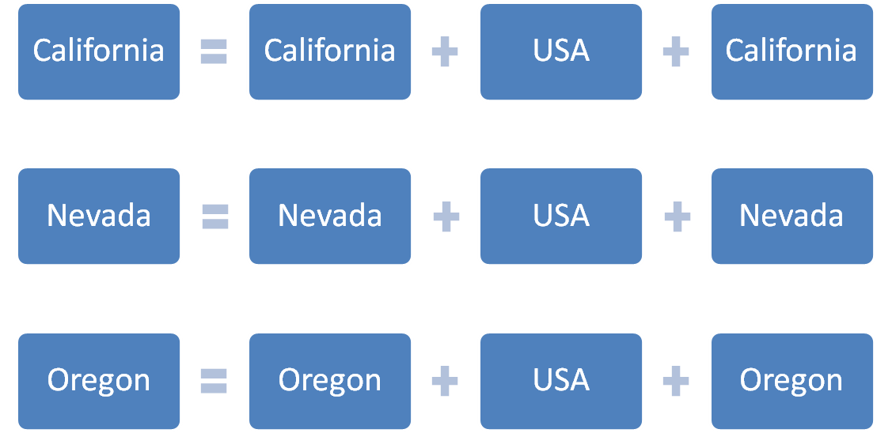
Pooled regressions
sa
Sales
Local media
Nat media
Local Price
+ ... + error
+ ... + error
+ ... + error
Notes:
From a conceptual perspective, there are two main strategies to pursue in marketing mix modeling. One is longitudinal; the other is cross-sectional or side-by-side analysis. In longitudinal analyses, the corporation looks at sales and profits over a number of time periods (months, quarters, years), compared to the marketing inputs in each of those time periods. In the cross-sectional approach, the corporation’s various sales territories each receive different marketing inputs at the same time, or these inputs are systematically varied across the sales territories, and are compared to the sales and profit outcomes. Both methods are sound, and both have their place. Often, some combination of the two methods is the most efficient.
The simplest form of pooled estimation consists in merely stacking the equations one above the other and run a OLS regression. All equations are estimated simultaneously and thus different checks on the residuals are necessary: for any region observations must be serially uncorrelated; across regions and time errors must be homoscedastic (constant variance)

Slide 55
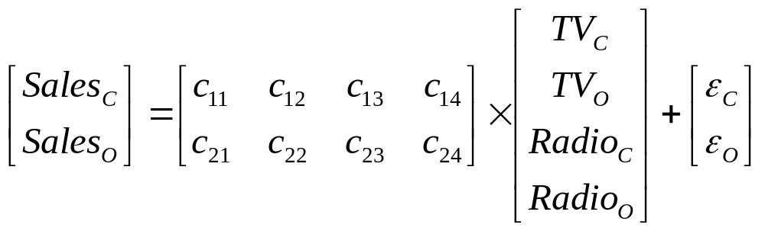
Pooled regressions example
SalesCalifornia = c11*TVCalifornia + c12*TVOregon+c13*RadioCalifornia +c14*RadioOregon + ErrorColifornia
SalesOregon = c21*TVCalifornia + c22*TVOregon+c23*RadioCalifornia +c24*RadioOregon + ErrorOregon
Media effect is also tested across regions

Slide 56
How advertising effects consumers?
  Understanding:
  the process by which advertising affects consumers
  How the effects of advertising are spread over time
  The role of different media
  The role of competitors

Slide 57
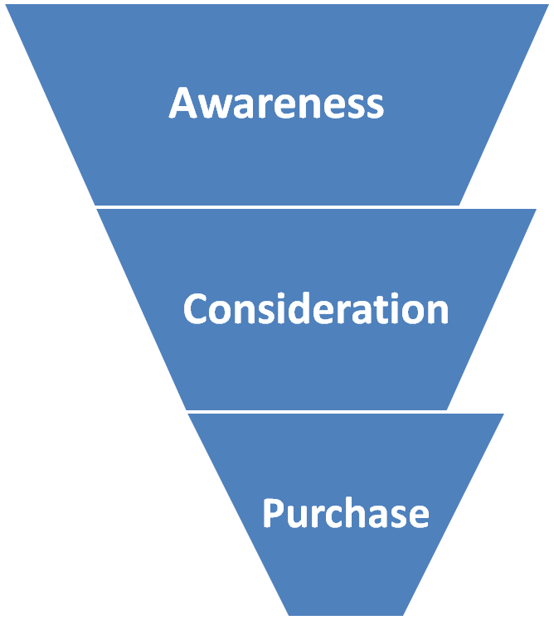
The purchase funnel
A basic process that leads to the purchase of a product consists in:
  Awareness – costumer is aware of the existence of a product
  Consideration – actively expressing an interest in the company
  Purchase
Notes:
The purchase or purchasing funnel is a consumer focused marketing model which illustrates the theoretical customer journey towards the purchase of a product or service.
1) AWARENESS – the customer is aware of the existence of a product or service
2) CONSIDERATION – actively expressing an interest in a product group
3) PURCHASE – taking the next step towards purchasing the chosen product
Awareness has been found to be a necessary condition for advertising effectiveness. When consumers who are unfamiliar with a product category have to choose between a well known brand and an unknown one, they usually select the well known one.
In cases where the purchase is somehow risky, for example buying an expensive product, brand consideration and differentiation proceed sales

Slide 58
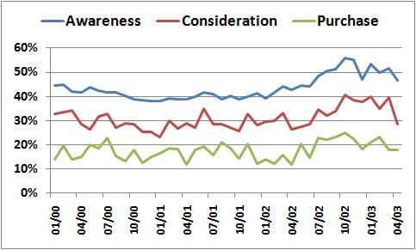
Working on survey data
A sample of the target audience is interviewed about brand awareness, consideration and choice
Research agencies provide awareness, consideration and purchase time series in % terms
  i.e. A purchase of 10% means that 10 out of 100 interviewed people purchased the product

Slide 59
Testing the purchase funnel
Awareness
Consideration
Purchase
Advertising first exercise its influence on awareness. Via awareness there is an effect on consideration which drives the consumer to purchase
Media

Slide 60
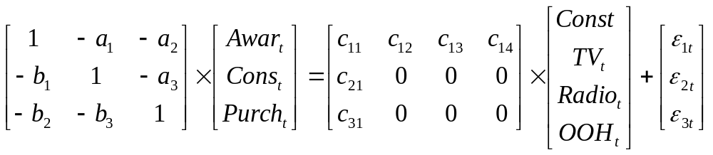
Testing the purchase funnel
Awarenesst=c11+c12*TVt+c13*radiot+c14*OOHt+error1t
Considerationt = b1*awarenesst + c21 + error2t
Purchaset = b3*Considerationt + b2*Awareness +c31 + error3t
a1,a2,a3 must be insignificant to confirm theory

Slide 61
Agenda
Business application of Marketing Mix modelling
A case study
Strengths and weaknesses
Brief introduction to more advanced approaches: pooled regressions and structural equations

Slide 62
References
Notes:
- Econometric Methods – Jack Johnston and John Dinardo – Fourth Edition
- “Which part of my marketing spend really works? – Marketing Mix Modelling may have an answer..“ Shaun Doyle
- Marketing Mix Modeling By Jerry W. Thomas - Marketingpower.com
- Understanding Advertising AdstockTransformations Joy, Joseph
-^ Broadbent, S. (1979) "One Way TV Advertisements Work", Journal of the Market Research Society Vol. 23 no.3.
http://www.marketing-metrics-made-simple.com/gross-rating-points.html
- Aaker, David A. (1991), Managing Brand Equity. New York: The Free Press
^ Keller, Kevin Lane (2003). “Brand Synthesis: The Multidimensionality of Brand Knowledge,” Journal of Consumer Research, 29 (4), 595-600
^ Leuthesser, L., C.S. Kohli and K.R. Harich (1995). “Brand Equity: The Halo Effect Measure,” European Journal of Marketing, 29 (4), 57-66.
^ a b Ailawadi, Kusum L., Donald R. Lehmann, and Scott A Neslin (2003). “Revenue Premium as an Outcome Measure of Brand Equity,” Journal of Marketing, 67 (October), 1-17
^ a b c Keller, Kevin Lane (1993). “Conceptualizing, Measuring, and Managing Customer-Based Brand Equity,” Journal of Marketing, 57 (January) 1-22
^ Lassar, W., B. Mittal and A. Sharma (1995). “Measuring Customer-Based Brand Equity,” Journal of Consumer Marketing, 12 (4), 11-19
^ a b Neumeier, Marty (2006). The Brand Gap: How to Bridge the Distance Between Business Strategy and Design, Berkekley, CA : New Riders Publishing.
^ Grannell, Chris (2009). "Untangling Brand Equity, Value and Health", Brandchannel, Fall 200
^ IEG: Sponsorship Glossary
^ Barry, Thomas. 1987. The Development of the Hierarchy of Effects: An Historical Perspective. Current Issues and Research in Advertising, 251-295.
^ A modern purchase funnel concept - Marketing-made-simple.com (2009): [1]
^ The customer decision journey - McKinsey Quarterly(2009): [2]
-Advertising effects on awareness, consideration, brand choice using tracking data – Philip Hans Franses and Marco Vriens

